Slide 1
ACDB CAMEL FILES
Case study of Tullamarine Airport Melbourne
Eric Peterson, Adjunct Senior Fellow, The University of Queensland in collaboration with
Queensland Department of Housing and Public Works Project Services Mechanical Engineers

Slide 2
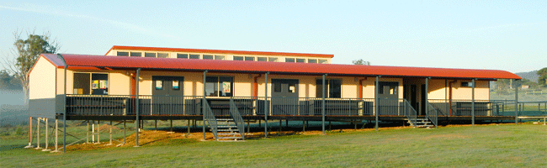
Desktop study of single story demountable classrooms

Slide 3
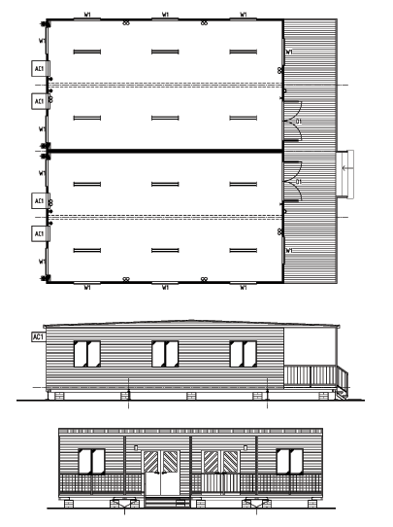
ATCO 158 m² twin classrooms with veranda metal clad with R1.5 insulation

Slide 4
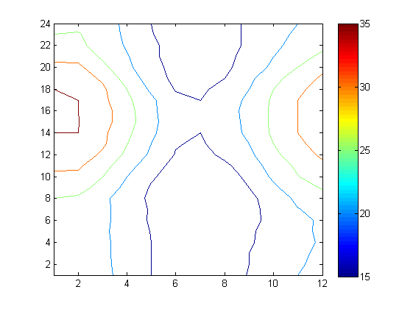
ACDB Design DB
Midnight
9 PM
6 PM
3 PM
Noon
9 AM
6 AM
3 AM
Midnight
Jan Feb Mar Apr May Jun Jul Aug Sep Oct Nov Dec

Slide 5
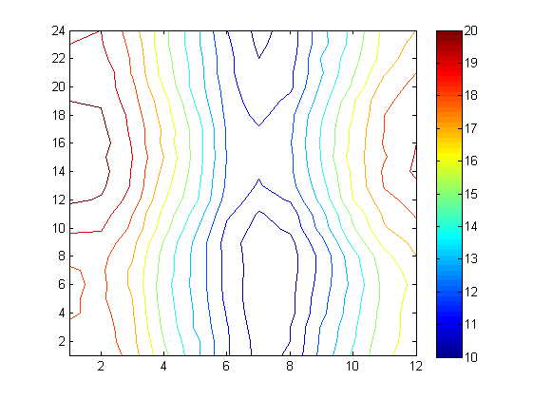
ACDB Design WB
Midnight
9 PM
6 PM
3 PM
Noon
9 AM
6 AM
3 AM
Midnight
Jan Feb Mar Apr May Jun Jul Aug Sep Oct Nov Dec

Slide 6
Results of CAMEL load estimates
 | CAMEL standard COMFORT Concurrent WB and DB | CAMEL standard CRITICAL 24 hr 0.25% | ACDB “Dry Summer” Design DB with mean coincid WB | ACDB “Wet Summer” Design WB with mean coincid DB | ACDB “moderately critical” concurrent design DB & design WB
kW GTH | 27.6 | 32.7 | 25.3 | 29.9 | 28.9
L/s supply | 1498 | 1729 | 1494 | 1289 | 1544
peak time | 3 PM January | 3 PM January | 4 PM January | 4 PM January | 4PM January
On-coil DB/WB | 26.8/18.0 | 27.4/18.3 | 27.0/17.0 | 26.3/18.1 | 24.9/26.9
Off-coil DB/WB | 13.5/12.3 | 13.8/12.5 | 13.1/11.6 | 13.1/12.0 | 13.6/12.4

Slide 7

CAMEL standard COMFORT
Concurrent WB and DB

Slide 8

CAMEL standard CRITICAL
24 hours 0.25 %

Slide 9

ACDB “Dry Summer”
Design DB with mean coincident WB

Slide 10

ACDB “Wet Summer”
Design WB with mean coincident DB

Slide 11

ACDB “moderately critical” concurrent design DB & design WB

Slide 12
HVAC equipment specification relative to CAMEL Standard Comfort
 | CAMEL standard COMFORT Concurrent WB and DB | CAMEL standard CRITICAL 24 hr 0.25% | ACDB “Dry Summer” Design DB with mean coincid WB | ACDB “Wet Summer” Design WB with mean coincid DB | ACDB “moderately critical” concurrent design DB & design WB
GTH | 27.6 kW | +18% | -27% | +17% | -4%
Supply air | 1498 L/s | +15% | -16% | -14% | +17%
temperature of coil fluid | 11.3 °C | higher | lower | lower | 11.2 °C
Air on-coil Air off-coil | 26.8/18.0 13.5/12.3 | 27.4/18.3 13.8/12.5 | 27.0/17.0 13.1/11.6 | Similar to CAMEL standard Comfort | Similar to CAMEL standard Critical
 |  |  | Need not dehumidify | Must dehumidify

Slide 13
Synthesis of Tullamarine desktop study
ACDB WB “Wet Summer” dehumidification specification for monsoon weather patterns
ACDB DB “Dry Summer” sensible specification for hot dry weather (consider evaporative cooler)
ACDB CR “Moderately Critical” specification is similar to “CAMEL standard COMFORT” but with increased supply air and lower coil temperature.
CAMEL standard CRITICAL: design for very rare weather pattern of heat and concurrent humidity

Slide 14
Design for both wet and dry with outdoor-air preconditioning unit
Suggest clients brief their Engineers to design outdoor air preconditioners for efficient operation in both wet and dry weather.
This may include redundant systems for the two sets of criteria: evaporative cooler for dry weather and dehumidification for monsoons.
Internal fan coil unit selections would not be influenced by outdoor extremes.

